Slide 1
CST 205 OOP :OBJECT ORIENTED CONCEPTS

Slide 2
OBJECTIVES
To explain about object oriented concepts.
To illustrate object oriented design principles.

Slide 3
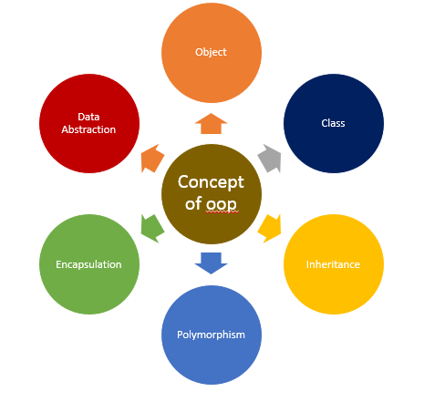
Basic Object Oriented concepts
Object means a real-world entity such as a pen, chair, table, computer, watch, etc
Object-Oriented Programming is a methodology or paradigm to design a program using classes and objects
The main aim of object-oriented programming is to implement real-world entities

Slide 4
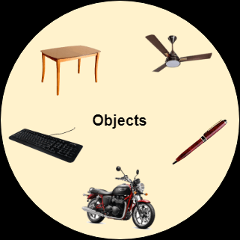
Basic Object Oriented concepts
Object
Any entity that has state and behavior is known as
an object.
For example, a chair, pen, table, keyboard, bike, etc.
It can be physical or logical.
They are the combination of data & logic that represents some real world entity.
Objects are the basic run‐time entities of an object oriented
system.

Slide 5
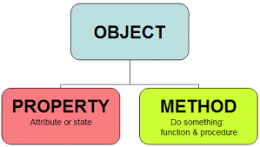
Basic Object Oriented concepts
Object
When a program is executed, the objects interact by sending messages to one another.
Each object contains data, and code to manipulate the data.
A dog is an object because it has states like color, name, breed, etc. as well as behaviors like wagging the tail, barking, eating, etc.

Slide 6
Basic Object Oriented concepts
Object
The data of the object can only be accessed by the methods of the object.
Consequently, the only access point to the data for the external Objects is through the invocation of the methods of the object.
No object can directly access the data of any other object.
An object can access the private data of another object by invoking the methods supported by that object.
This mechanism of hiding data from other objects is popularly known as the principle of data hiding or data abstraction
The data stored internally in an object are called its attributes, and the operations supported by an object are called its methods.

Slide 7
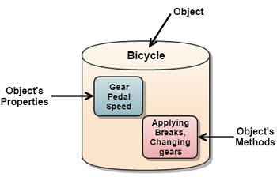
Basic Object Oriented concepts

Slide 8
Basic Object Oriented concepts
CLASS
Collection of objects is called class.
CLASS are a blueprint or a set of instructions to build a specific type of object.
An object is an instance of a class.
Class in Java determines how an object will behave and what the object will contain.
Let’s take Human Being as a class. My name is John, and I am an instance/object of the class Human Being.
Object has a physical existence while a class is just a logical definition.

Slide 9
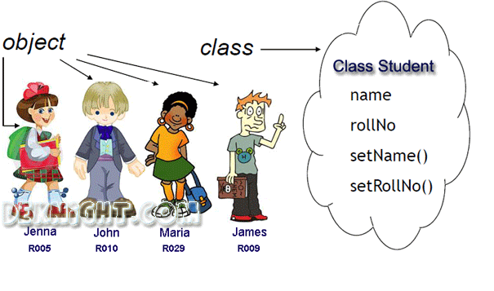
Basic Object Oriented concepts

Slide 10
CLASS
Car is the class and wheels, speed limits, mileage are their properties.
A Class is a user defined data-type which has data members and member functions.
Data members are the data variables and member functions are the functions used to manipulate these variables and together these data members and member functions defines the properties and behavior of the objects in a Class.
In the above example of class Car, the data member will be speed limit, mileage etc and member functions can be apply brakes, increase speed etc.

Slide 11
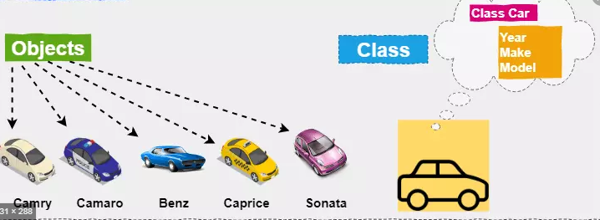
Basic Object Oriented concepts

Slide 12
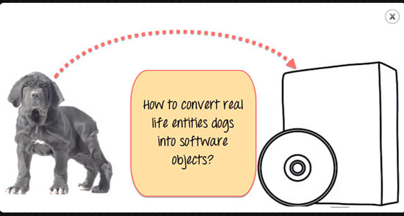
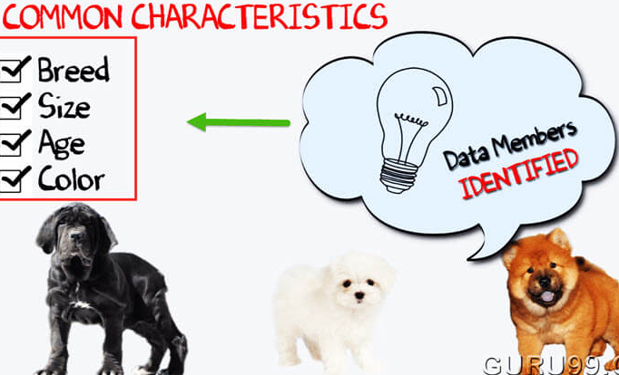
Understand the concept of Java Classes and Objects with an example.

Slide 13
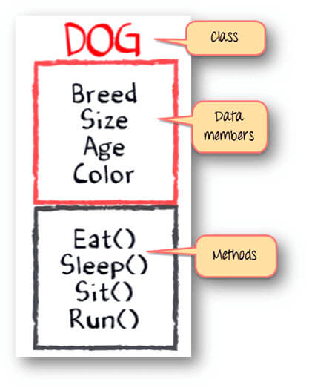
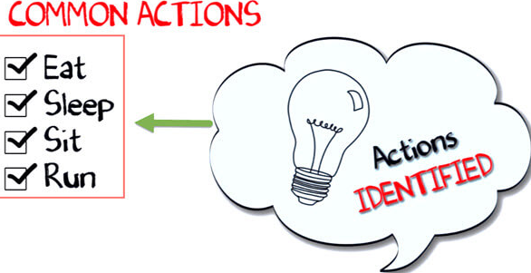
Understand the concept of Java Classes and Objects with an example.
Class - Dogs
Data members or objects- size, age, color, breed, etc.
Methods- eat, sleep, sit and run.

Slide 14
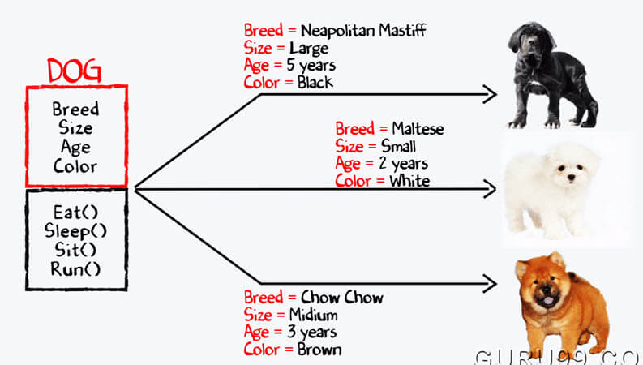
Understand the concept of Java Classes and Objects with an example.

Slide 15
What are the four basic principles/ building blocks of OOP (object oriented programming)?
Inheritance
Encapsulation
Abstraction
Polymorphism

Slide 16
Basic Object Oriented concepts
Inheritance
The capability of a class to derive properties and characteristic from another class is called Inheritance.
Sub Class : The class that inherits properties from another class
is called Sub class or Derived Class.
Super Class : The class whose properties are inherited by sub
class is called Base Class or Super class.
The subclass can add its own fields and methods in addition to the superclass fields and methods.
It supports the concept of hierarchical classification.

Slide 17
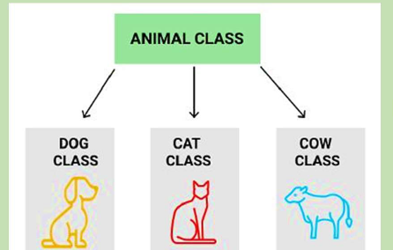
Basic Object Oriented concepts
Inheritance :- Reusability:
Inheritance supports the concept of “reusability”,i.e. when we want to create a new class and there is already a class that includes some of the code that we want, we can derive our new class from the existing class. By doing this, we are reusing the fields and methods of the existing class.

Slide 18
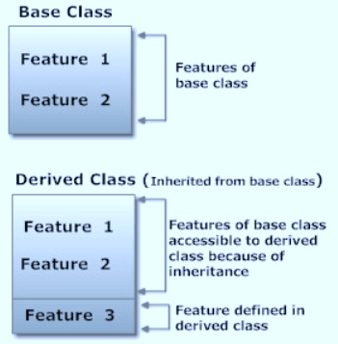
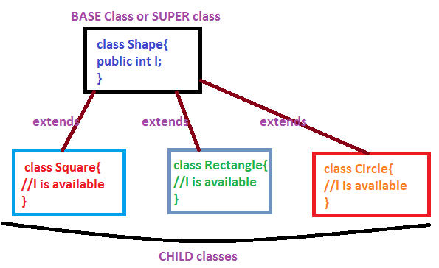
Basic Object Oriented concepts - Inheritance

Slide 19
Basic Object Oriented concepts
Inheritance :-
Each derived class can be considered as a specialisation of its base class because it modifies or extends the basic properties of the base class in certain ways.
Therefore, the inheritance relationship can be viewed as a generalisation-specialisation relationship.
In addition to inheriting all the data and methods of the base class, a derived class usually defines some new data and methods.
A derived class may even redefine a method which already exists in the base class.

Slide 20
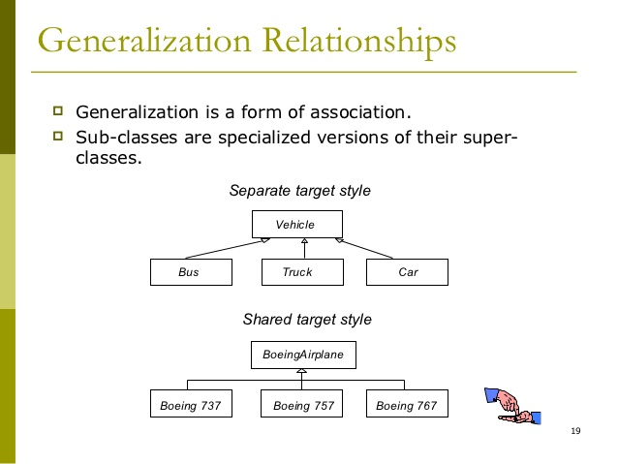
Generalization

Slide 21
Basic Object Oriented concepts
Advantages of inheritance
Reusability: facility to use methods of base class with out rewriting the same.
Data hiding: Using access specifiers, base class can decide to keep some data private so that it cannot be altered by the derive class.
Extensibility: extending the base class logic.
Through effective use of inheritance, you can save lot of time in your programming and also reduce errors, which in turn will increase the quality of work and productivity.
.

Slide 22
Basic Object Oriented concepts
Encapsulation
It is the process of binding both attributes and methods together in a single unit , as a class.
Through encapsulation, the internal details of a class can be hidden from outside.
It permits the elements of the class to be accessed from outside only through the interface provided by the class.

Slide 23
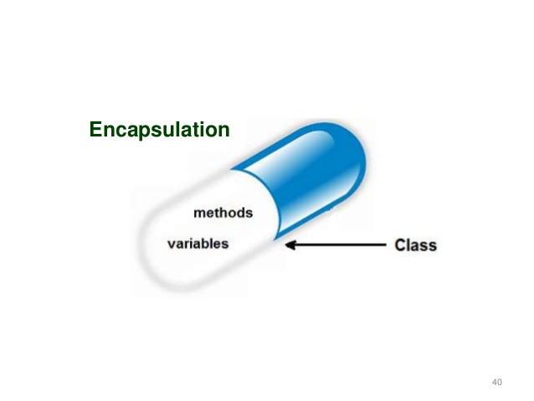
Basic Object Oriented concepts
Encapsulation
Binding (or wrapping) code and data together into a
single unit are known as encapsulation
For example: consider a Medical store. Lets say you have to buy
some medicines. You go to the medical store and ask the chemist for the medicines. Only the chemist has access to the medicines in the store based on your prescription .Chemist knows what medicines to give to you.
In this example
MEDICAL STORE: class
MEDICINES: Member Variables.
CHEMIST: Member Methods.
You: External Application or piece of Code accessing members with method in class

Slide 24
Basic Object Oriented concepts :Encapsulation
Through Encapsulation, Data is not accessible to the outside world, and only those functions which are wrapped in the class can access it.
In encapsulation, the variables of a class will be hidden from other classes and can be accessed only through the methods of their current class. Therefore, it is also known as data hiding.
To achieve encapsulation in Java −
Declare the variables of a class as private for data hiding.
Provide public setter and getter methods to modify and view the variables values.

Slide 25
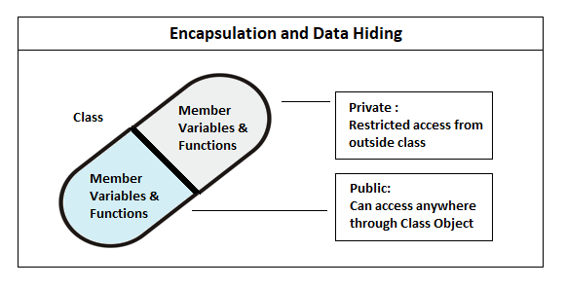
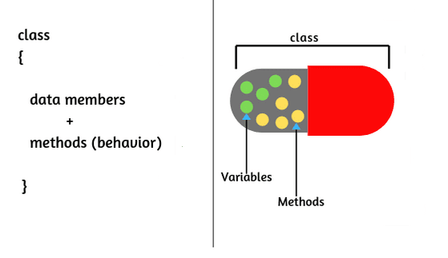
Basic Object Oriented concepts :Encapsulation

Slide 26
Basic Object Oriented concepts :Encapsulation
Data Hiding: It is a way to achieve data hiding in Java because other class will not be able to access the data through the private data members.
Protection of data from accidental corruption,by means of access specifiers (Private/Public),it provides security.
Encapsulation protects an object from unwanted access by clients.
Increased Flexibility: We can make the variables of the class as read-only or write-only depending on our requirement.
Reduction in complexity.

Slide 27
Basic Object Oriented concepts
Abstraction
Data Abstraction is the property by virtue of which only the essential details are displayed to the user.
Data Abstraction may also be defined as the process of identifying only the required characteristics of an object ignoring the irrelevant details.
In other words, the user will have the information on what the object does instead of how it does it.
The trivial or the non-essentials units are not displayed to the user. Ex: A car is viewed as a car rather than its individual components.

Slide 28
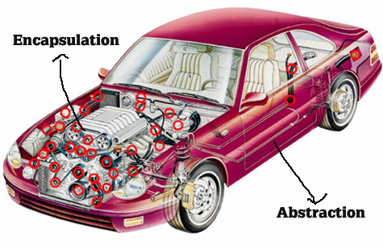
Basic Object Oriented concepts
Abstraction
Consider a real-life example of a man driving a car.
The man only knows that pressing the accelerators will increase the speed of car or applying brakes will stop the car but he does not know about how on pressing the accelerator the speed is actually increasing, he does not know about the inner mechanism of the car or the implementation of accelerator, brakes etc in the car.
In java, abstraction is achieved by interfaces
and abstract classes.

Slide 29
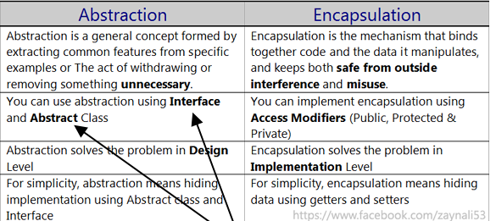
ABSTRACTION VS ENCAPSULATION

Slide 30
Basic Object Oriented concepts
POLYMORPHISM
The word polymorphism means having many forms. Poly means many and morph means form; which means objects can take many different forms .
Suppose if you are in class room that time you behave like a student, when you are in market at that time you behave like a customer, when you at your home at that time you behave like a son or daughter, Here one person present in different-different behaviors.
An operation may exhibit different behaviours in different instances. The behavior depends upon the types of data used in the operation.

Slide 31
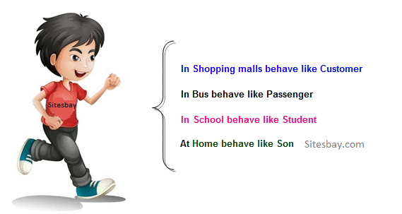
Basic Object Oriented concepts
POLYMORPHISM

Slide 32
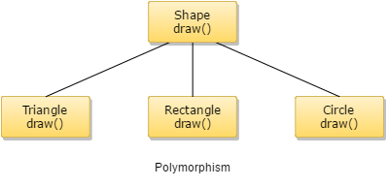
Basic Object Oriented concepts
POLYMORPHISM
An operation may exhibit different behaviours in different instances. The behavior depends upon the types of data used in the operation.

Slide 33
Basic Object Oriented concepts
How to achieve Polymorphism in Java ?
In java programming the Polymorphism principal is implemented with method overriding concept of java.
Polymorphism principal is divided into two sub principal they are:
Static or Compile time polymorphism
Dynamic or Runtime polymorphism
Static polymorphism in Java is achieved by method overloading and Dynamic polymorphism in Java is achieved by method overriding.

Slide 34
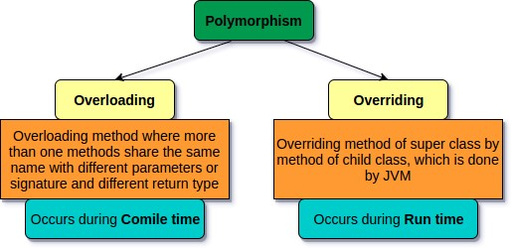
Basic Object Oriented concepts

Slide 35
Basic Object Oriented concepts
Method overloading allows methods that perform similar or closely related functions to be accessed through a common name. Method overloading allows you to define three methods with the same name and different types of parameters to handle the array of operations.
Method overriding allows a sub class to use all the general definitions that a super class provides and add specialized definitions through overridden methods.
Method overriding works together with inheritance to enable code reuse of existing classes without the need for re-compilation.
It helps the programmer to reuse the codes.

Slide 36
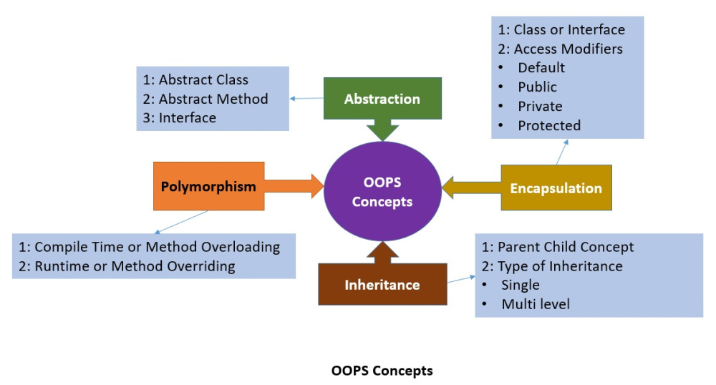
Basic Object Oriented concepts

Slide 37
Benefits of OOD
User can create new user defined data type by making class.
Data can be encapsulated from outside world .
By using polymorphism, same functions or operators can be used for multitasking.
Object oriented system can be easily upgrade from small system to large system.
Software complexity can be easily managed.
Maintenances cost is less.
Code reuse by the use of predeveloped class libraries.
Code reuse due to inheritance
Simpler and more intuitive abstraction, i.e., better management of inherent problem and code complexity
Better problem decomposition.

Slide 38
Disadvantages of OOD
The principles of abstraction, data hiding, inheritance, etc. do incur run time overhead due to the additional code that gets generated on account of these features. This causes an project-oriented program to run a little slower than an equivalent procedural program.
An important consequence of object-orientation is that the data that is centralised in a procedural implementation, gets scattered across various objects in an object-oriented implementation. Therefore, the spatial locality of data becomes weak and this leads to higher cache miss ratios and consequently to larger memory access times. This finally shows up as increased program run time.

Slide 39
Summary
Object means a real-world entity such as a pen, chair, table, computer, watch, etc.
Object-Oriented Programming is a methodology or paradigm to design a program using classes and objects.
It simplifies software development and maintenance by providing some concepts:
Object
Class
Inheritance
Polymorphism
Abstraction
Encapsulation

Slide 40
Thanks!
Any questions?

